Slide 1

Fraud/Risk Analysis and Predication
© Nihilent Technologies 2013

Slide 2
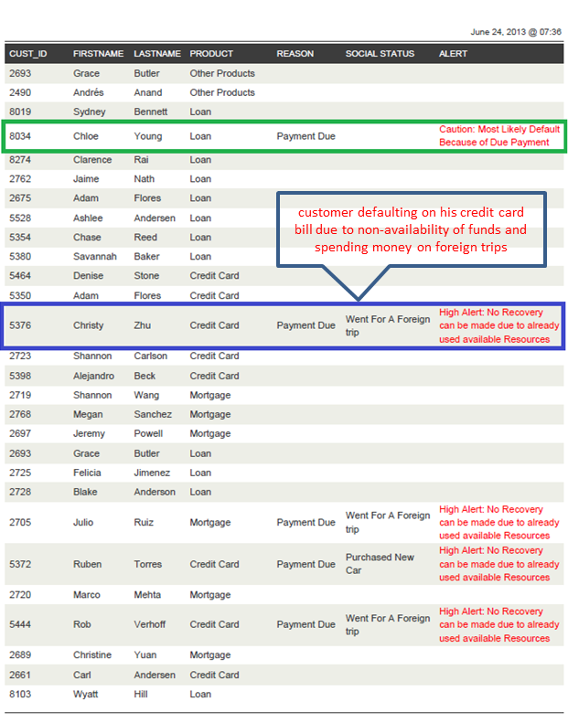
Fraud Predication Analysis: Report
© Nihilent Technologies 2013

